Slide 1

Introduction to Sequence Informatics
Institute of Infection and Global Health

Slide 2
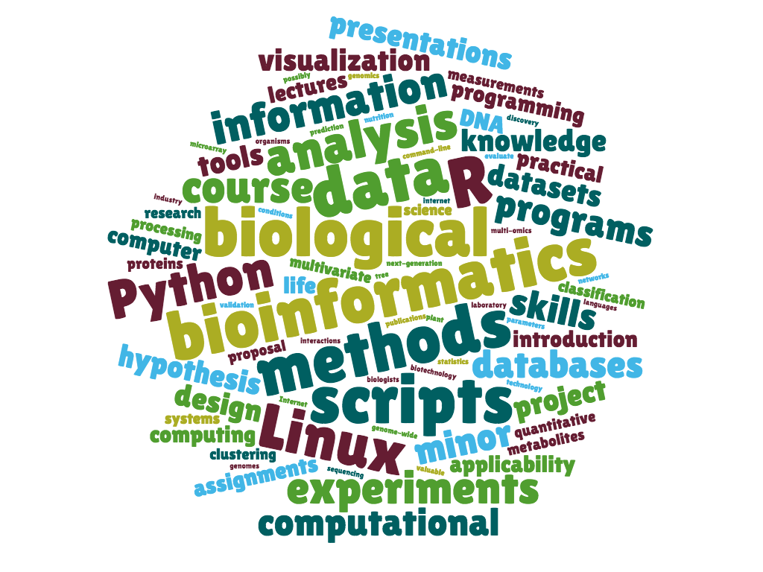
Course overview

Slide 3
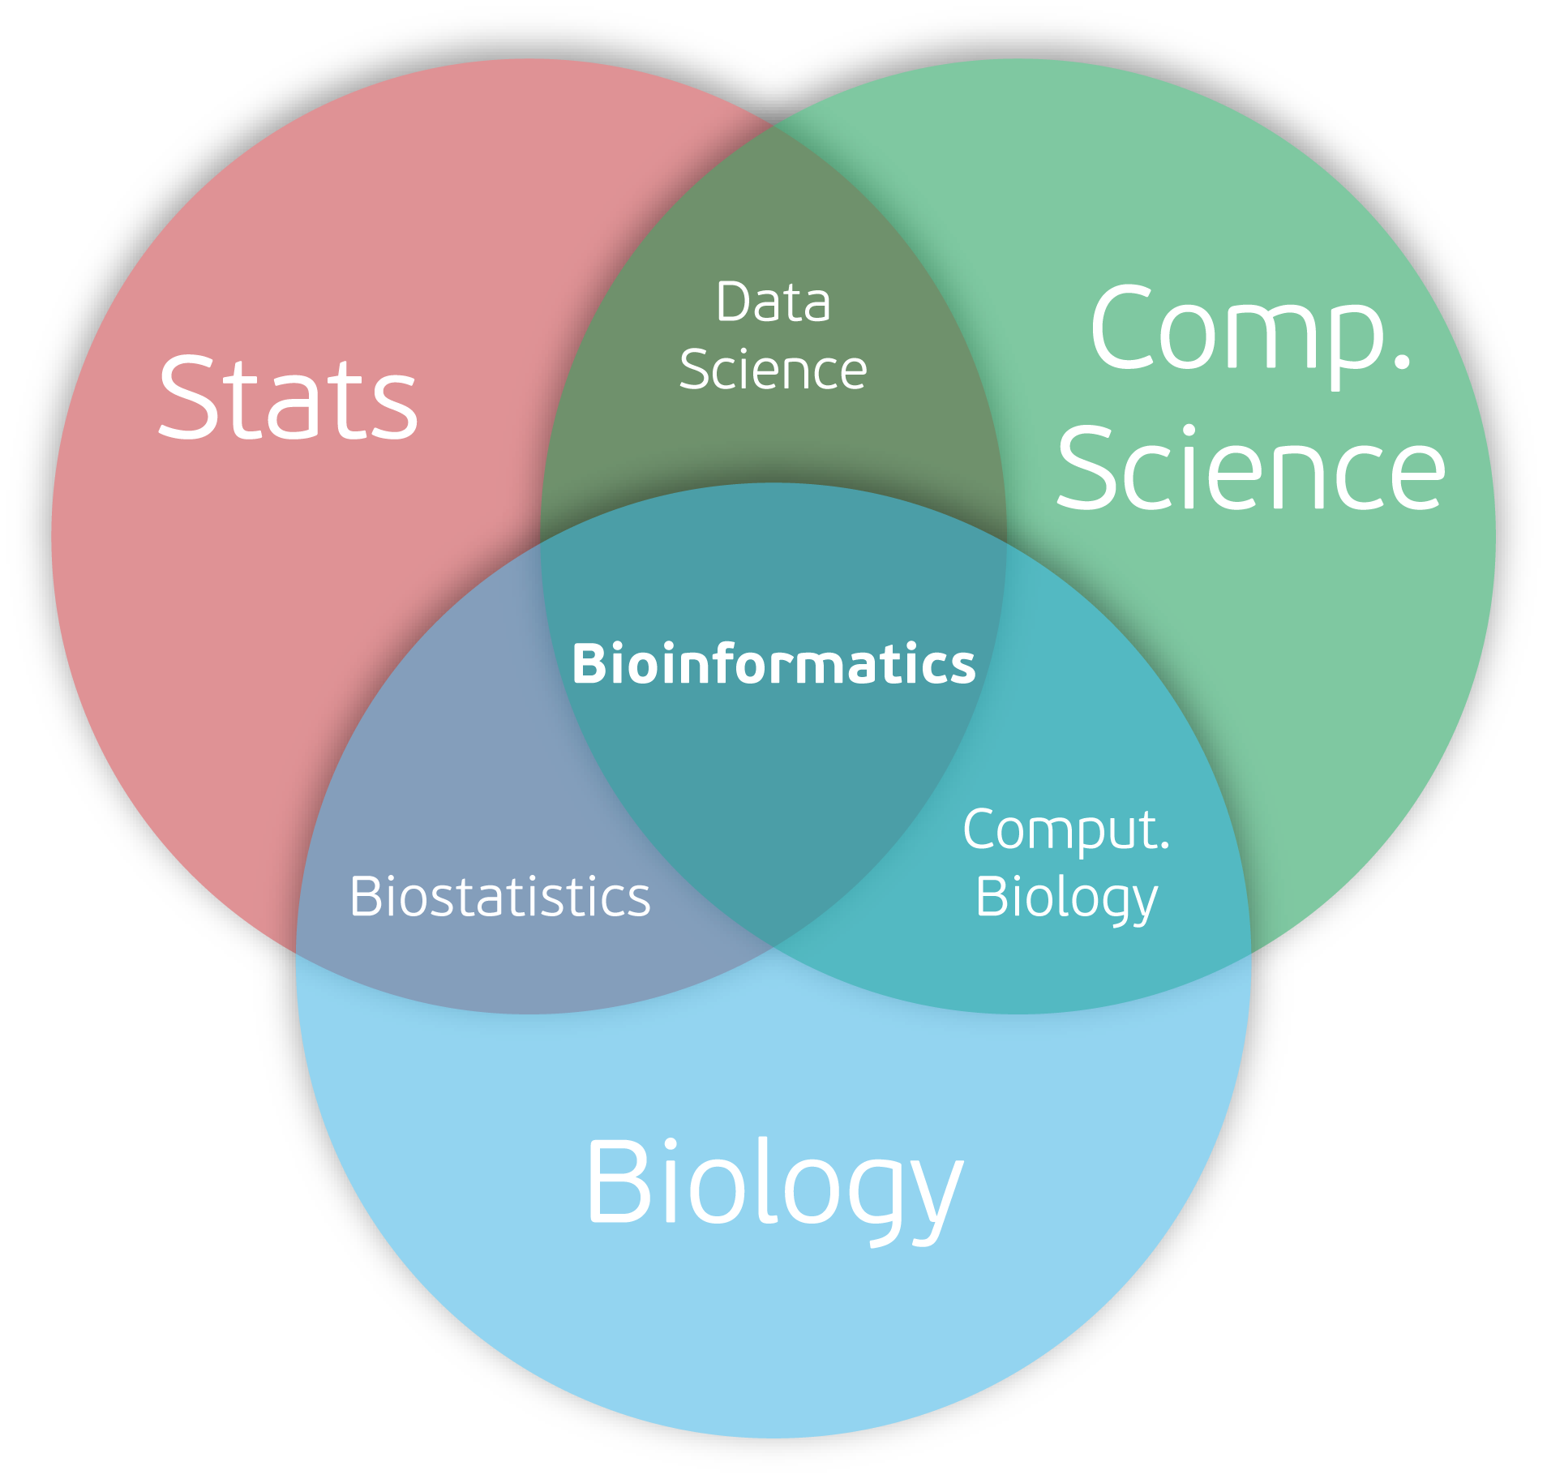

Slide 4
Course overview
Session | Topic
1 | UNIX and command line environment
2 | Genomics: sequencing, assembly and annotation
3 | Programming in R
4 | Genomics: mapping and population analysis
5 | Transcriptomics and differential expression
6 | Extended exercise

Slide 5
Introduction to UNIX

Slide 6
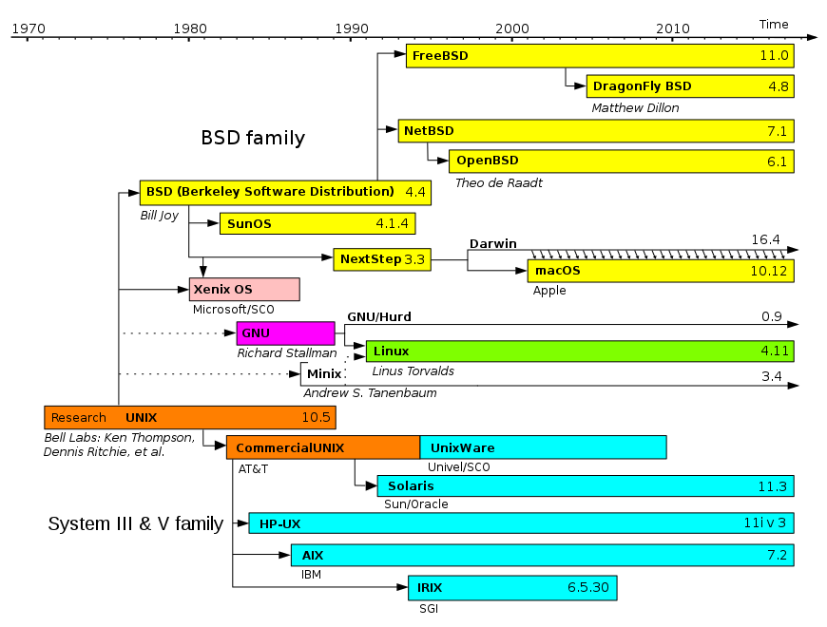
What is UNIX?
A family of operating systems that all share a common origin
Linux, MacOS and Android were all originally based on UNIX
Windows is NOT based on UNIX
Linux was developed on the basis of free and open-source software
There are hundreds of Linux variants known as distros, including Android for phones
During this course we will be using the server version of Ubuntu, one of the most popular distros

Slide 7
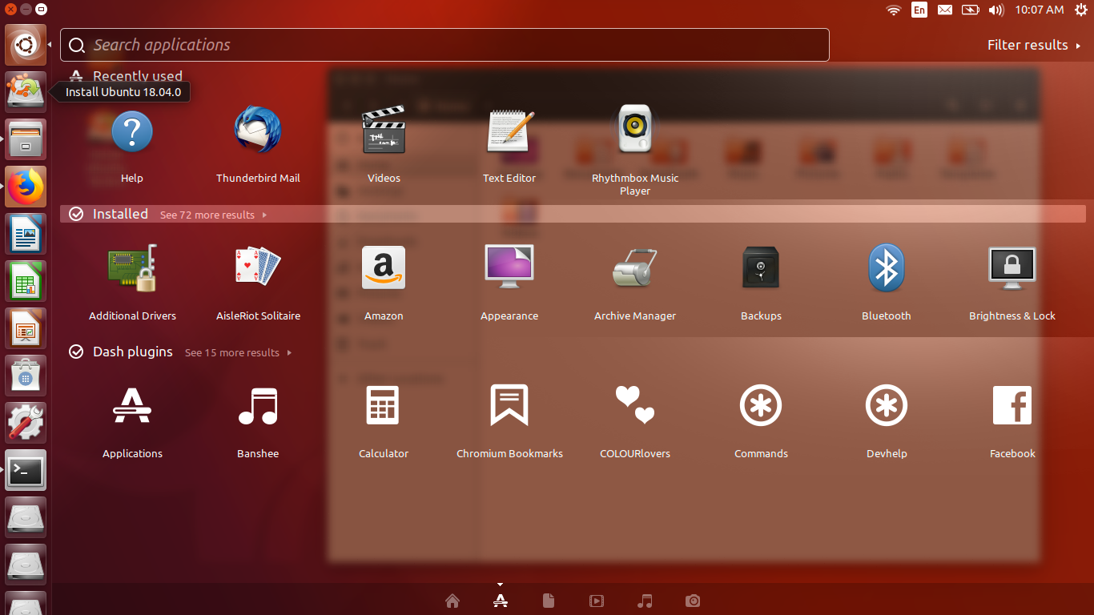
The Ubuntu Desktop
We, however, will be using the Command Line Interface…

Slide 8
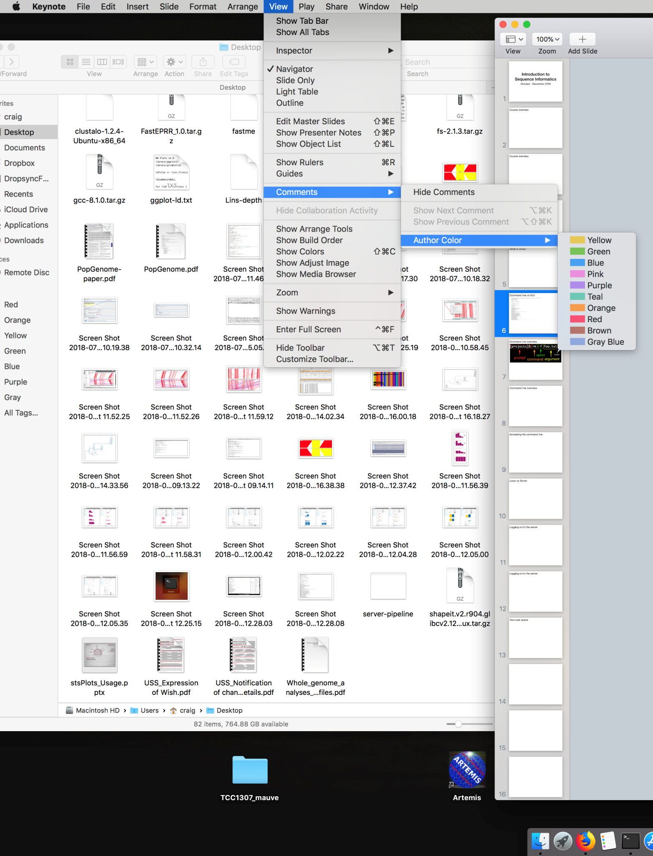
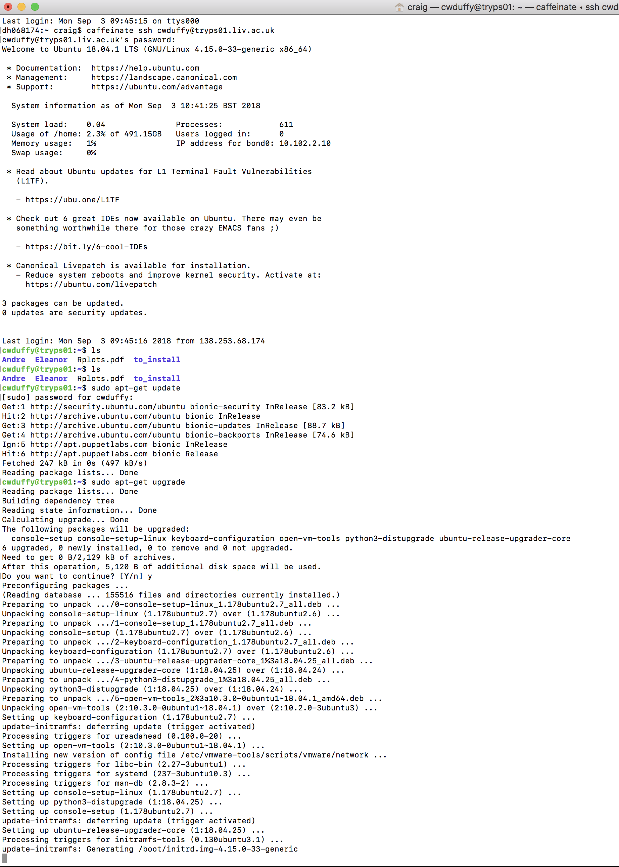
GUI vs Command Line

Slide 9
GUI vs Command Line
GUI
Pros
Visually intuitive, easy to use
Easy multitasking - A window for each program
Often packaged ‘all in one’ with the required libraries and dependencies
Cons
Resource intensive - The computer has to both run the task and update the visuals on a regular basis
Set options one click at a time
Repeating a task takes just as many clicks as the first time
Can’t just add code on the fly
A lot of work to design
Command Line
Pros
Powerful - Can combine options and even multiple programs into a single command
Option to write quick scripts - perl, python, R etc
Low resource requirements - More available for the actual program
Can quickly repeat commands
Cons
Steep learning curve
Easy to make mistakes
Manuals are often missing or incomplete
Software is reliant on associated dependencies which may be missing

Slide 10
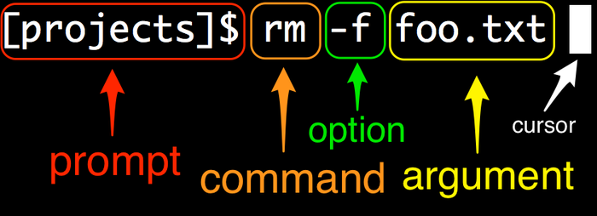
Command line overview

Slide 11
Command line overview
Terminal: Prompt: Command: Option: Argument: Cursor:
The most common piece of software used to access the command line A fixed piece of information displayed by the terminal. This may include the computer ID, user ID or current location The name of the program to be run An optional setting for the program. You may specify multiple options and they may be combined, so -f -d becomes -fd. An option may require an argument, which should be specified immediately after the option
A parameter that needs to be supplied to the program, either as part of an option or on its own (for example an input file) The current cursor position where text will appear

Slide 12
Command line overview
We are in the projects directory
Run the remove command
Remove the file by force without prompting for confirmation
The name of the file to be removed

Slide 13
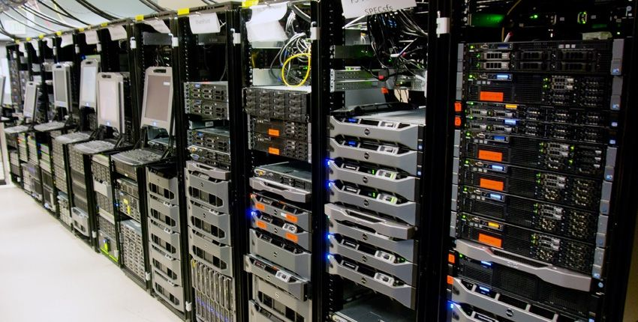
Working on a Server
For large scale computational analysis (such as bioinformatics) it is common to offload the work to a server
May be as small as a single PC or an entire building full of computers operating in parallel
Provide a dedicated resource for analysis
For this course we will be using tryps01, a bioinformatics server here at the University
tryps01
56 processing cores 126 Gb RAM 8 Tb storage space

Slide 14
Your user space
Personal directory for completing the exercises and practicing in
Default name for the folder is the username you have been provided – this is a temporary account, if you were a regular user you would have a dedicated working space
You are free to create files and directories within this space but cannot affect the contents of any other directory
Log on to tryps01 following the commands provided in the handout

Slide 15
Exercise One
By the end of this exercise you will have learned to:
Navigate from one directory to another on the command line
Create, copy, move and delete files or directories
Extract data from a zip file
Examine the contents of text files
Redirect the output of a command into a file
The basics of downloading and compiling a program

Slide 16
When it all goes wrong…
You will make mistakes. When you do:
Check what you have typed - have you missed a , “” or -?
Check the names of your files - are they correct, did you miss the extension (.txt etc)?
Check your spelling – The command line is case sensitive.
Read the error message – most people overlook this even though it usually provides a lot of valuable information.
Check the manual/help - did you include the correct options and arguments?
If in doubt:
Google it!

Slide 17


Slide 18
Aligning sequences with BLAST

Slide 19
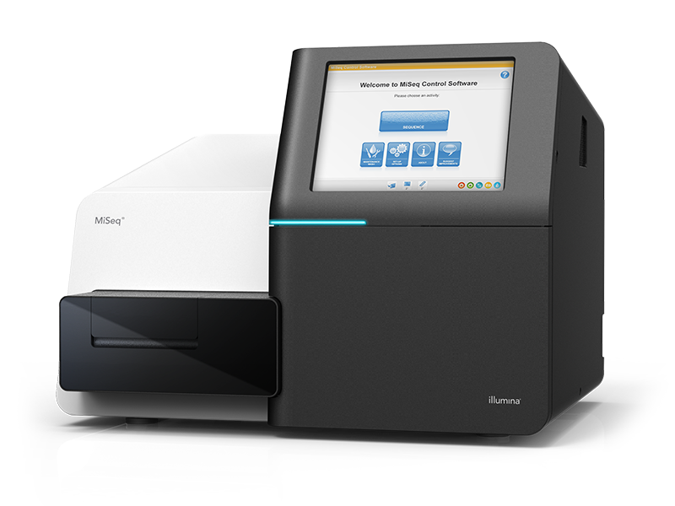
Examining sequence data
The core of this course is the analysis of sequence data. Sequences may come in many formats but the two most common types are:
Nucleotide
Protein
This data will often be fragmented or incomplete. We may not know its species of origin and even when we do it is unlikely that we will know which gene or protein it represents (if any)
The most common way to identify unknown sequences is to run a BLAST search against a database of known sequences.
Basic Local Alignment Search Tool

Slide 20
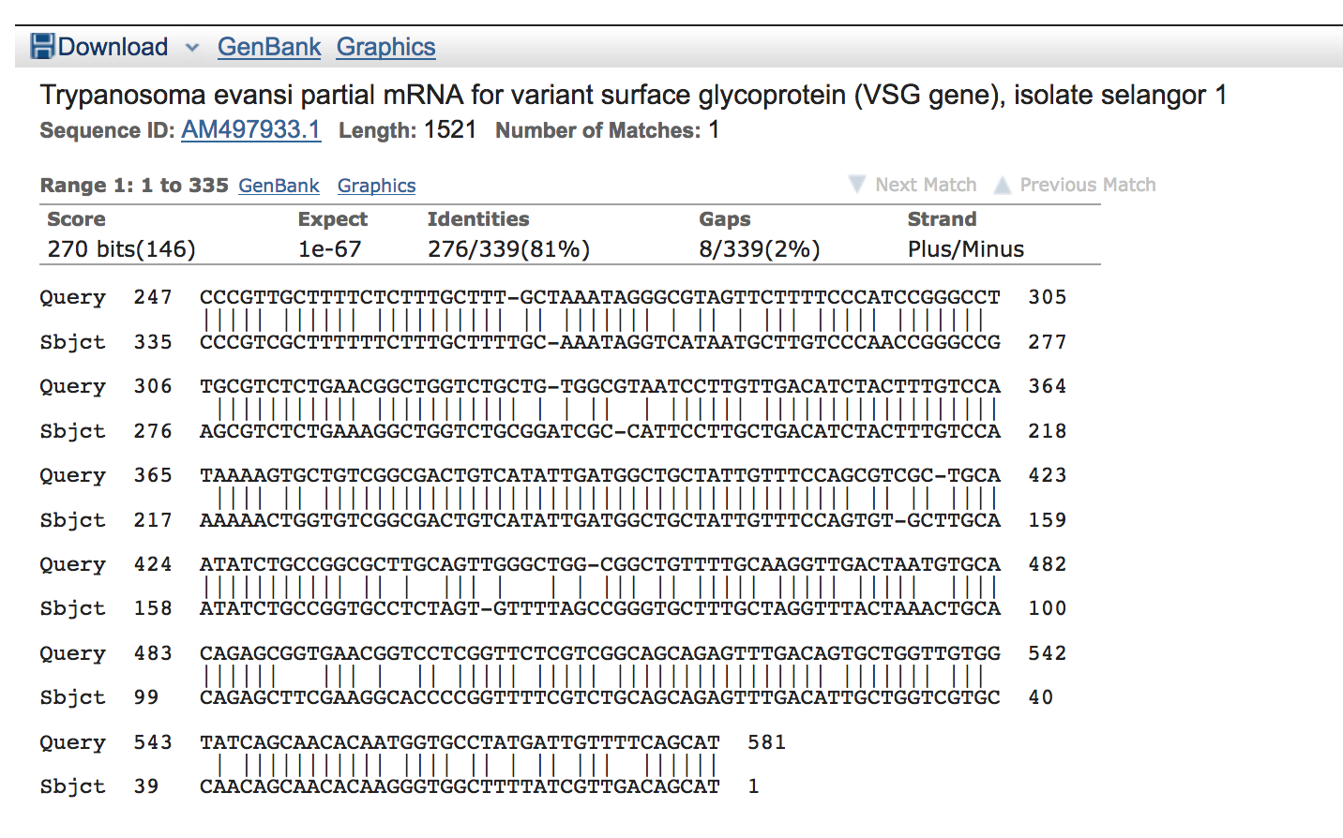
Interpreting BLAST results

Slide 21
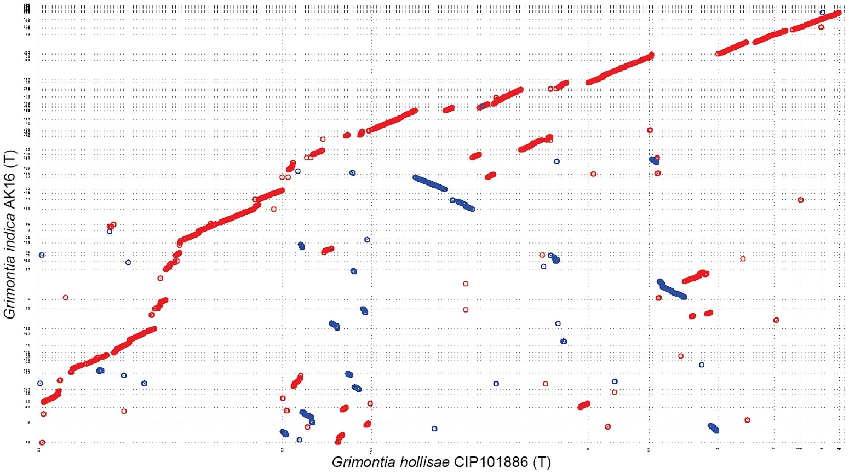
Sequence Alignments
BLAST is just one form of performing local sequence alignments. It is has been optimised to quickly align short sequences against large databases.
During this course we will perform many different types of sequence alignment as the process is central to the analysis of sequencing data.
During exercise 3 you will use MUMmer, which has been designed to quickly aligned entire chromosomes against one another.
MUMmer can be used to assess the completeness of a new genome assembly, identify evolutionarily conserved sequences and to detect large scale chromosomal rearrangements.

Slide 22
Exercises Two and Three
By the end of the exercises you will have learned to:
Create a local BLAST database and use it to identify hits against three target sequences
Examine and assess the BLAST results
Compare chromosomal sequences for collinearity using a second form of local alignment.

